Slide 1
Appendix for learning Git
By MMED 2015 mentors
Eva, Joseph, Roxy & Ivy
AIMS – South Africa, Muizenberg

Slide 2
Git definions
git help
git status: Check the status of your repository
git stage: Filters files to be considered by Git
git commit: Create a checkable version of the repository
git branch: Create a branch of a git repository.
git merge: Add changes made on branched repository to the main/original repository.
git push: Incorporate your local committed changes to the online GitHub repository.
git pull: Incorporate the newest changes of an online repository, to your local repository.
git checkout: Navigate to another repository you want to check.
git fetch: Get the newest changes of an online repository.

Slide 3
Getting started
GitHub
Go on https://github.com/ and create a GitHub account.
Git
Download git from http://git-scm.com/downloads. Install the version corresponding to your OS.
Introduce yourself to git.
Open a Terminal (Mac & Linux) or Git Shell (Windows). Type in the following code:
git config --global user.name “YourName"
Set your email. It has to be the same as the one you used to sign up for a GitHub.com account. Type the following command:
git config --global user.email “your.email.address"

Slide 4
Getting started (cont …)
SmartGit
Go to http://www.SmartGitapp.com/Git
Download the version compatible to your OS (Mac or Windows)
Follow the prompted commands.
Enter your full name and email
Choose the option to install the self-contained Git version to be used by when prompted
Skip the Mercurial option
Choose Putty as SSH option
Enter your github.com username and password
Note: Use the same email address as your user name

Slide 5
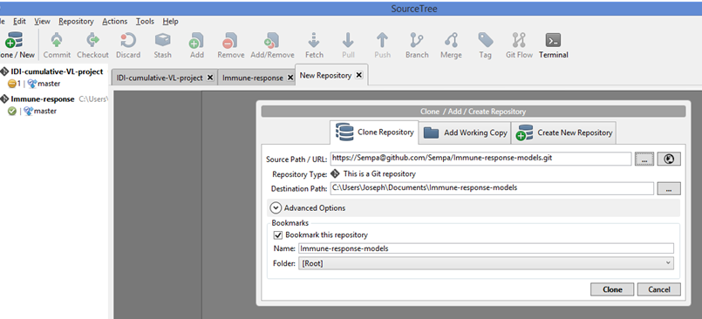
Local clone of an online repository
SmartGit
Linux
Create a git new folder similar to online repo:
git clone https://github.com/EvaLiliane/MyRepo.git
Local Git Repo: MyRepo
(Existing project comes with his version history)
Make a targeted empty folder similar to a git repo:
git init
git remote add origin https://github.com/EvaLiliane/MyRepo.git
git fetch
git checkout -t origin/master
Local Git Repo: Targeted folder’s name
(Not sure whether the entire version history get downloaded)
Step 1
Step 2
Step 3
Notes:
Open SmartGit and while there do the following
Step 1: Click on Clone / New to bring up the dialogue box “Clone / Add / Create Repository”
Step 2: Click on the most right icon opposite “Source Path/ URL”. This will take you to a list of your online repositories under your username. While there pick the repository you want to clone
Step 3: Click on the most right icon opposite “Destination Path”. This will help you choose a local folder on your machine where you want to host the repository. This folder MUST be empty else you will receive an error message
After process to click on Clone

Slide 6
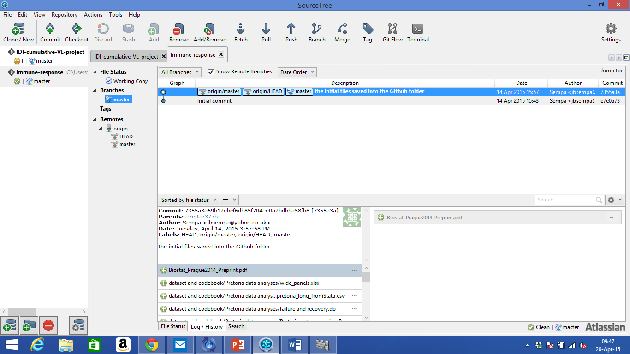
After cloning …
Click on:
SmartGit
Branches: You find local branches.
Note that any commits made on these local branches will be kept locally
Remotes: Origin—copy of remote repository at GitHub.com
Clean: Bottom right—shows whether you have uncommitted changes
Linux
git branch
git remote
Be cautious ! : git clean
Unlike SmartGit, this will remove all untracked file from that working repo.
Notes:
Ref: https://github.com/GSoft-SharePoint/Dynamite/wiki/Git-step-by-step:-Part-1
For Linux:
git branch –a list all local and remote branches
git branch –r list only remote branches
git branch list only local branches
git show-branch list branches with their commits.
git remote list all available remote (-v adds the url after the name)

Slide 7
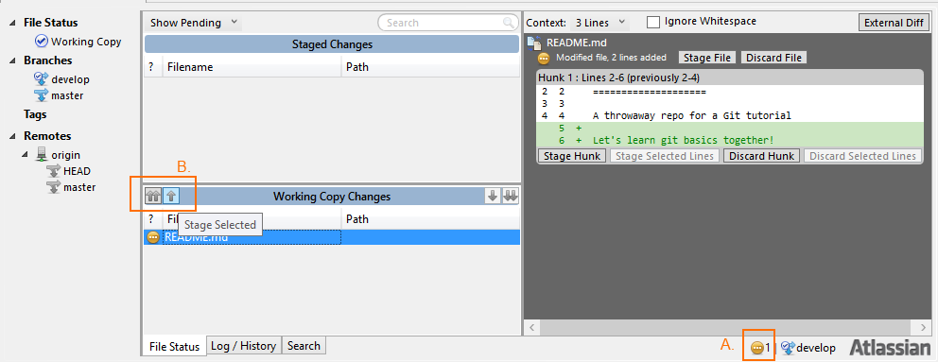
Commit
Linux
git commit –a
(Stage changes)
git commit –m “Your commit message here”
Remember, committing is telling git that the current state of all your files is important. Make sure that new files have been added first.
Note: You need to have made change(s) to a file in the local repository.
SmartGit
A: Shows you have unsaved changes
B: Allows you to stage changes. First click on the files that you want to commit then click on ‘B’
Notes:
Reference: https://github.com/GSoft-SharePoint/Dynamite/wiki/Git-step-by-step:-Part-2

Slide 8

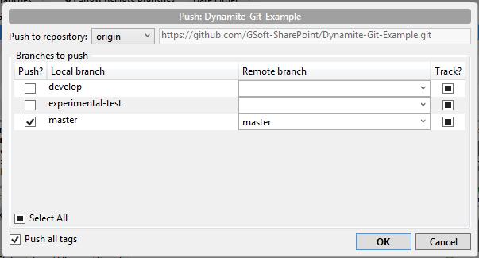
Push/Pull
11
Linux
Bring changes from online repository to your local repository
git pull origin
Push changes from your local repository to the online repository
git push origin master
SmartGit
Assuming you are working from one station / PC
21
Notes:
Click on Push at the top of the screen. This gives you an option to select which branches you want to push
Checking the develop branch, you want your local development branch to track it remote.
Click on ‘OK’ in the bottom right. See the output that follows

Slide 9
References
Tutorials/Readings
https://training.github.com/kit/
https://help.github.com/categories/bootcamp/
http://readwrite.com/2013/09/30/understanding-github-a-journey-for-beginners-part-1
http://readwrite.com/2013/10/02/github-for-beginners-part-2
http://rogerdudler.github.io/git-guide/
https://github.com/GSoft-SharePoint/Dynamite/wiki
http://developers.useflashpunk.net/t/how-to-use-SmartGit-and-github-to-send-your-fp-modifications-pull-requests/1586
http://dexterlin.com/programming/creating-local-git-repositories-with-SmartGit/
Cheat Sheets
http://rogerdudler.github.io/git-guide/files/git_cheat_sheet.pdf
https://training.github.com/kit/downloads/github-git-cheat-sheet.pdf

